Slide 1
Trade Tide User Manual

Slide 2
Home Page
Purpose: Welcome users and provide navigation.
Features: Sign Up, Login, Info links.
Usage: Click 'Sign Up' to create a new account or 'Login' to access your account.

Slide 3
Sign Up Page
Purpose: Register new user accounts.
Fields: Name, Email, Password, Confirm Password.
Additional: Terms checkbox, social sign-up (Google, Facebook).

Slide 4
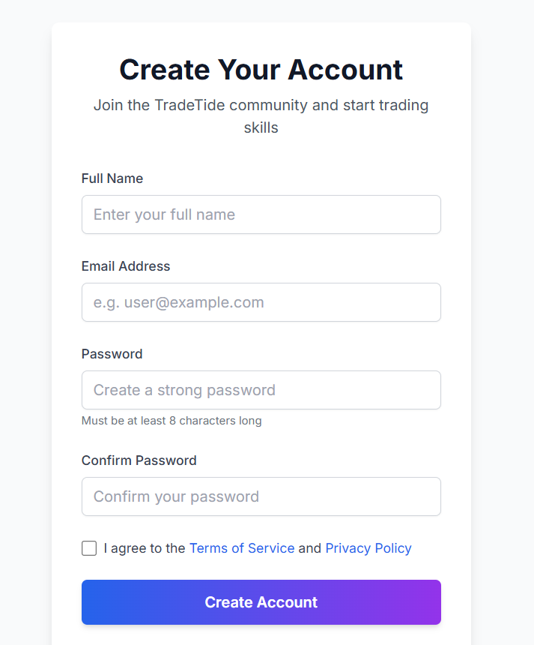

Slide 5
Login Page
Purpose: Allow user access.
Fields: Email, Password.
Additional: Forgot password link, error feedback.

Slide 6
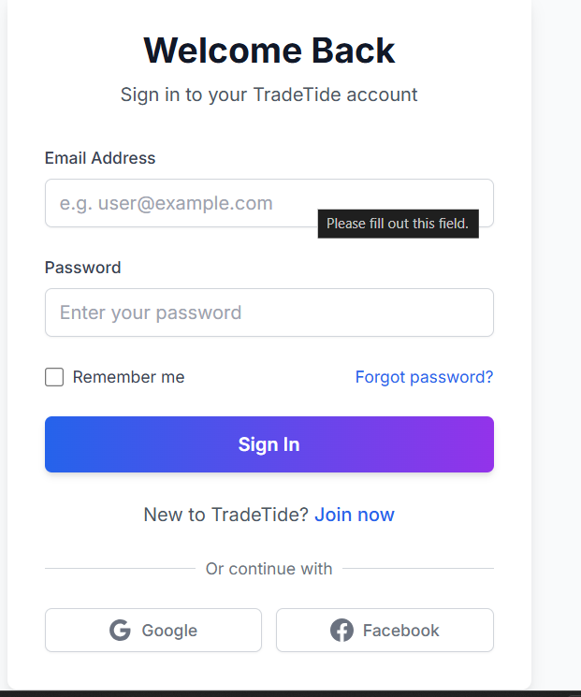

Slide 7
Password Reset Page
Purpose: Recover access to account.
Process: Submit email, receive reset instructions.

Slide 8
User Dashboard
Main user interface after login.
Features: Account overview, navigation to all core sections.

Slide 9
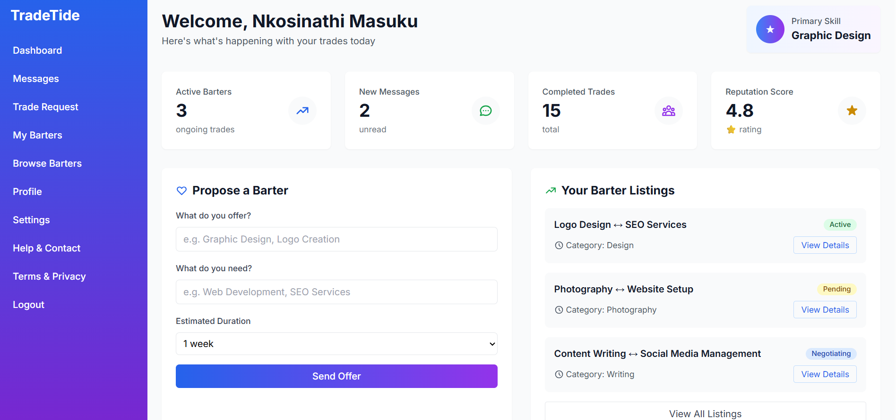

Slide 10
User Profile Page
View and edit personal information.
Options: Skills, bio, profile picture, etc.

Slide 11
Skill Listings Page
Displays all skill listings.
Functions: Search, filter, add/edit/delete skills.

Slide 12
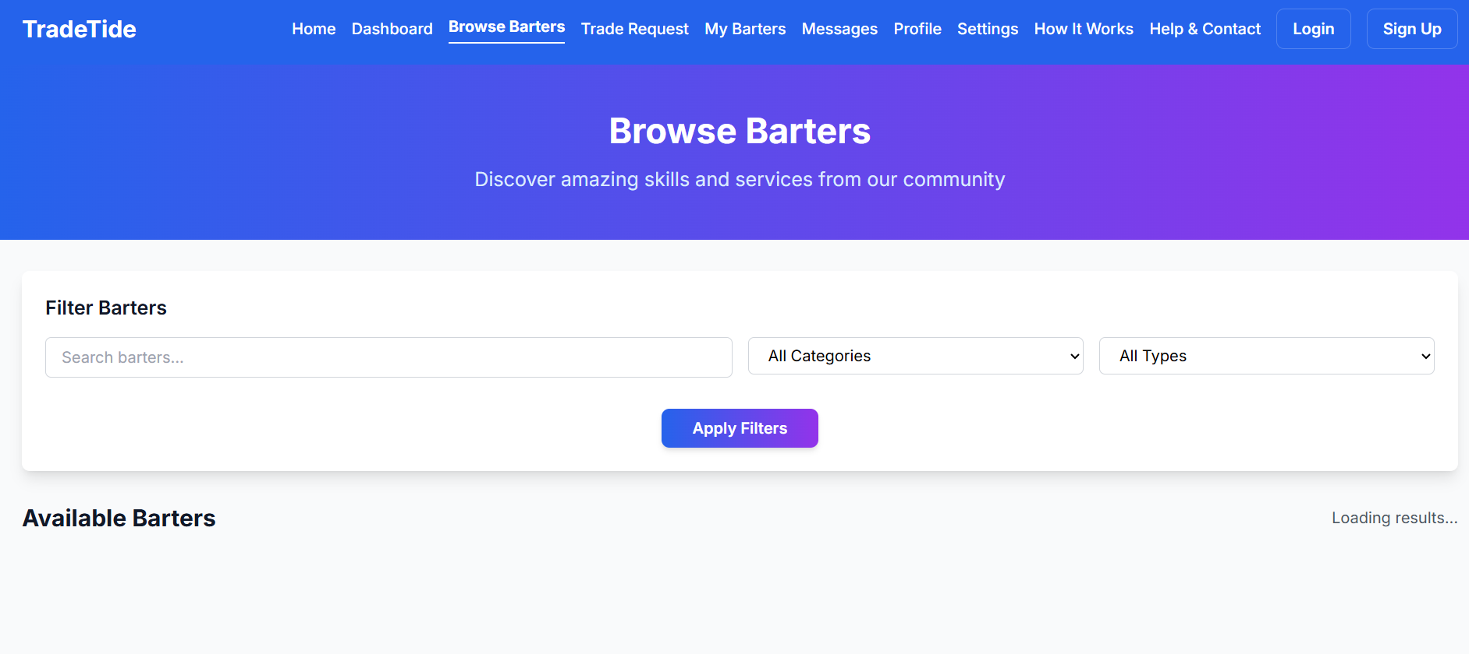

Slide 13
Create New Trade Post
Create a trade offer.
Fields: Title, description, skill category, availability.

Slide 14
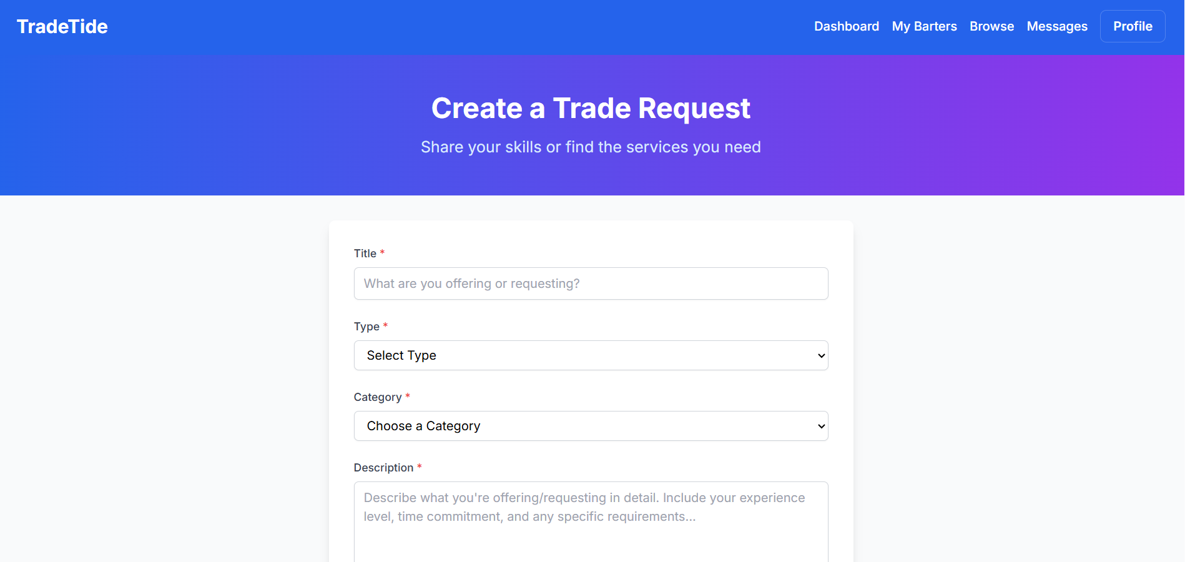

Slide 15
Messages Page
Communicate with other users.
Includes inbox, sent, and message creation.

Slide 16
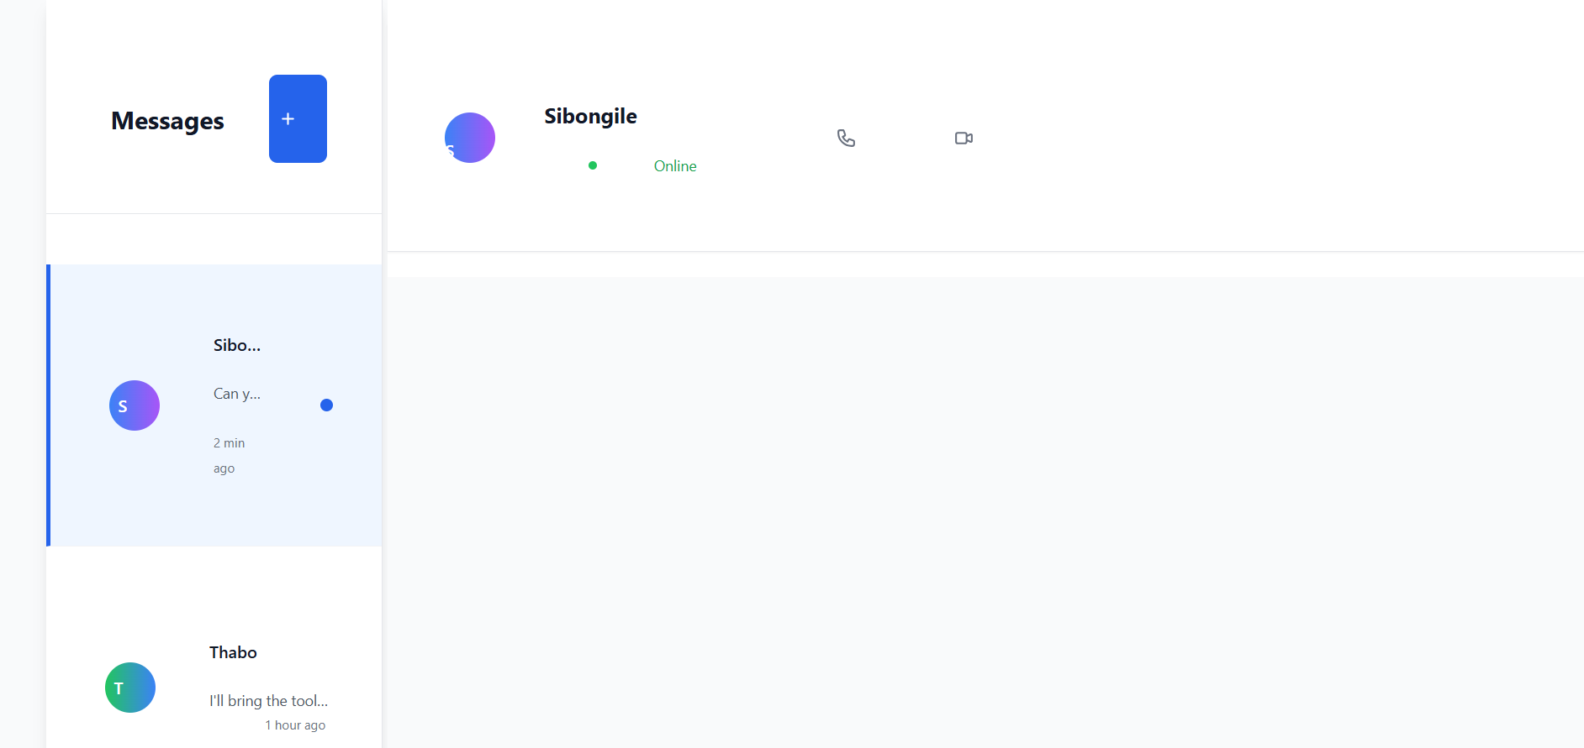

Slide 17
Notifications Page
View trade updates and alerts.
Options: Mark read/unread, delete.

Slide 18
Settings Page
Adjust account configurations.
Options: Password, email preferences, privacy.

Slide 19
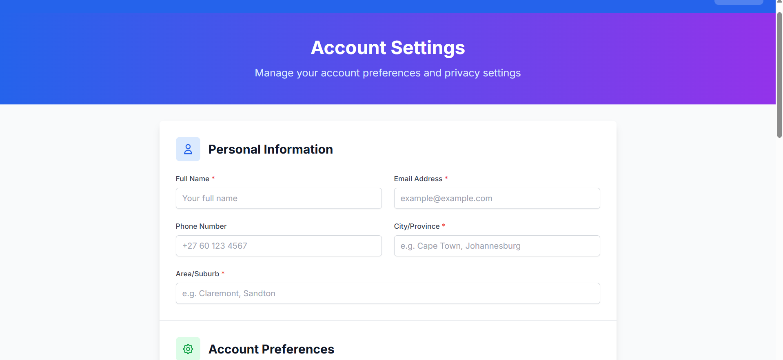

Slide 20
Legal Pages
Terms of Service: Legal usage terms.
Privacy Policy: Data usage and handling details.

Slide 21
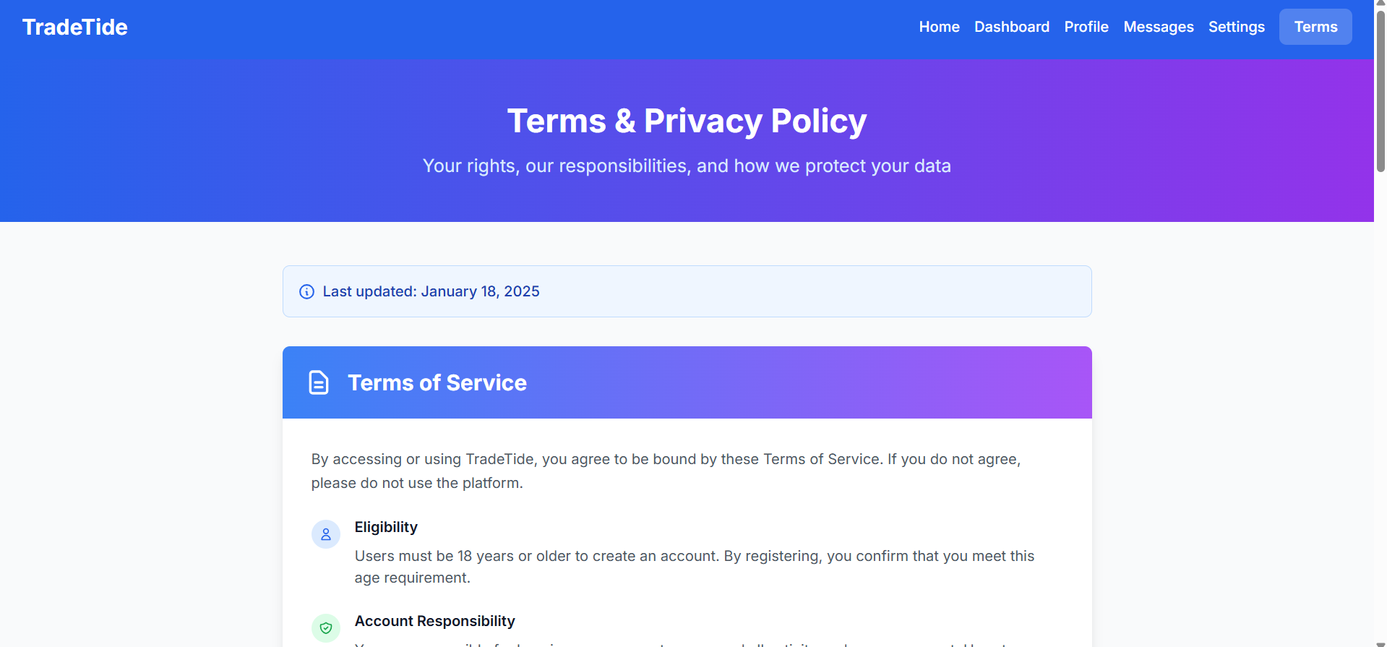

Slide 22
How to Use TradeTide
Create an account and verify email.
Log in and build profile.
Post trade offers and connect with others.
Manage notifications and settings.

Slide 23
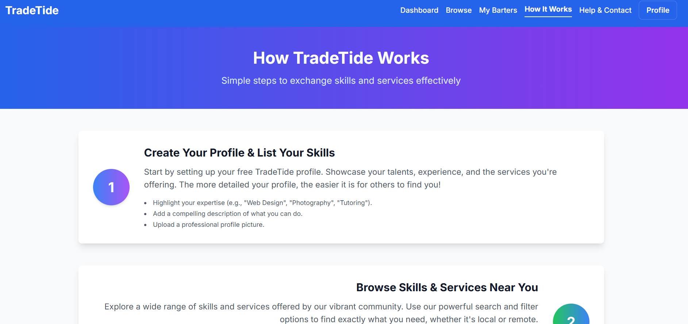

Slide 24
Troubleshooting & FAQ
Password errors, login issues, page not loading.
Ensure all fields are filled before posting.
Contact: support@tradetide.com

